Slide 1




SCIENTIFIC FOUNDATION OF HEALTH

Slide 2




FRIENDS AND FRIENDSHIP “THE VALUE OF RELATIONSHIP AND COMMUNICATION”

Slide 3
Team Members

Slide 4
CONTENTS
Communication is the key for healthy relationships
Building trust in friendships
Maintaining and rebuilding trust in friendships

Slide 5
The role of friendship in different life stages
Childhood (0-12 years):
Friendships in childhood provide companionship, playmates, and socialization skills.
They help children learn important social norms, empathy, and conflict resolution.
Friendships foster emotional development, offering a sense of belonging and security.
Adolescence (13-19 years):
During adolescence, friendships become central as peers often replace parents as the primary source of support and influence.
Friendships offer validation, acceptance, and identity formation as teenagers navigate complex social dynamics.
They serve as a buffer against stress, providing emotional support and understanding during this transitional period.

Slide 6
Young Adulthood (20-39 years):
In young adulthood, friendships continue to be essential for emotional support, but they also play a role in personal and professional development.
Friends may share similar life experiences, goals, and interests, providing a network for socializing, career networking, and mutual growth.
Friendships in this stage often involve shared activities, adventures, and exploration of life's possibilities.
Middle Adulthood (40-59 years):
Friendships during middle adulthood offer stability, continuity, and a sense of belonging during significant life changes such as marriage, parenthood, and career advancements.
They provide companionship and support as individuals juggle multiple responsibilities, including family and work obligations.

Slide 7
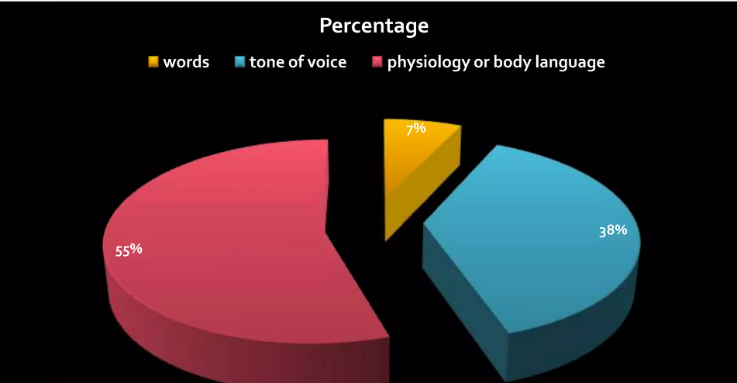
Communication is the key
In simple words ,Communication means that a message was sent,was received and was understood.
Factors affecting the communication >>>
Using multiple channels for good communication:
Body movements and postures~facial expressions~Gestures
~Eye contact~voice volume,tone,rate&inflection
Communication with parents:This is because effective communication builds understanding &trust with parents,at the same time this allows parents to understand wts happening for children&work together to support them.
Communication with teachers:One should not hesitate , to ask doubts .Helps in personal growth and learning process.

Slide 8
Communication with friends: Be truthful &honest.Don’t blindly trust others (Trust but verify).Respect each other and their privacy.Equal efforts from both sides.
Communication is the key to successful relationship,attentiveness&consistency.Without it there is no relationship.
Lack of communication ruins everything because instead of knowing how the other person is feeling ,we just assume.
Communication to a relationship is like oxygen to life ,without it ,it dies.
The biggest communication problem is we don’t listen to understand we listen to reply.
Communicate.Even when it’s uncomfortable or uneasy.One of the best way to heal ,is simply getting everything out.
Good communication keeps friends connected &involved in each other’s lives,no matter the physical distance between them.
In essence communication is the glue that holds relationships together,enabling people to navigate challenges and celebrate successes as a united front.

Slide 9





Building Trust in Friendships
Reliability:
Keep your promises and be dependable. Consistent actions build a sense of security.
Honesty:
Be truthful, even when it's difficult. Honesty fosters openness and authenticity.
Transparency:
Share your thoughts and feelings openly to prevent misunderstandings.

Slide 10




Maintaining and Rebuilding Trust in Friendships
Communication:
Maintain regular and open communication. Listen actively and share honestly.
Accountability:
Own up to your mistakes and make amends. Taking responsibility shows integrity.
Consistency:
Consistent behavior over time reinforces trust. Show up and be there for your friends.

Slide 11



Rebuilding Trust:
Sincere Apology : Acknowledge the mistake and offer a genuine apology.
Forgiveness : Both parties need to be willing to forgive and move forward.
Action and Patience: Demonstrate change through consistent actions and give it time.
“Trust is the glue of life . It’s the most essential ingredient in effective communication . It’s the foundational principle that holds all relationship”
- Stephen Covey

Slide 16

SUMMARY
Friendship and communication are essential aspects of human life, providing emotional support, companionship, and a sense of belonging.
Friendships enrich our lives by offering comfort, understanding, and shared experiences, which contribute to our overall well-being and happiness.
Effective communication is the cornerstone of strong friendships, allowing for open expression of thoughts and feelings, fostering trust, and resolving conflicts.
Good friends act as a support system during challenging times, offering advice, empathy, and encouragement.

Slide 17
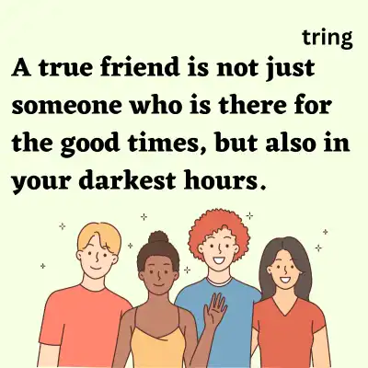
Additionally, friends can influence personal growth by providing different perspectives and constructive feedback.
Maintaining healthy friendships requires effort, including regular communication, active listening, and mutual respect.
The reciprocal nature of friendship means that both parties benefit, creating a balanced and fulfilling relationship.
Investing in friendships enriches one's life with joy, laughter, and a deeper understanding of oneself and others.

Slide 18
Bibliography
Bing browser
Wikipedia
Microsoft power point shapes

